Slide 1
ENVIRONMENTAL INFLUENCES ON CONSUMER BEHAVIOR
Lesson-5:

Slide 2
Consumers don't exist in a vacuum. Their behavior is influenced by the environment in which they live, and this behavior includes their buying behavior. This environment includes families and friends, lifestyle and lifecycle, and the culture and beliefs of their social class. When marketers understand how these influences work, they can often tap into them as they develop marketing strategies.

Slide 3
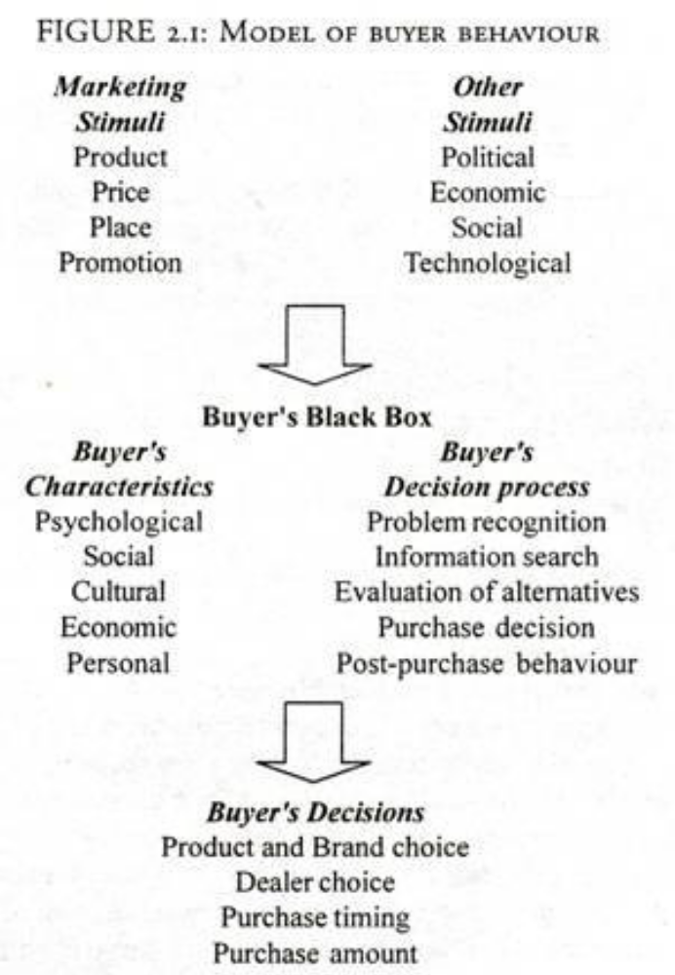

Slide 4
Environmental Factors Affecting Consumer Behavior:
It is defined as a complex sum total of knowledge, belief, traditions, customs, art, moral law or any other habit acquired by people as members of society. Our consumer behavior, that is the things we buy are influenced by our background or culture. Different emphasis is given by different cultures for the buying, use, and disposing of products. People in South India have a certain style of consumption of food, clothing, savings, etc. This differs from the people in the North of India. Different cultures and habits are predominant in different parts of the world. Japanese have a different culture from that of USA, England or Arab countries. Therefore, in consumer behavior culture plays a very important part.
• Sub-cultural Influences
• Social Class
• Social Group Influences
• Family Influence
• Personal Influences
• Other Influences

Slide 5
Sub-cultural Influences:
Within a culture, there are many groups or segments of people with distinct customs, traditions and behavior. In the Indian culture itself, we have many subcultures, the culture of the South, the North, East and the West. Hindu culture, Muslim culture, Hindus of the South differ in culture from the Hindus of the North and so on. Products are designed to suit a target group of customers which have similar cultural background and are homogeneous in many aspects.

Slide 6
Social Class:
By social class we refer to the group of people who share equal positions in a society. Social class is defined by parameters like income, education, occupation, etc. Within a social class, people share the same values and beliefs and tend to purchase similar kinds of products. Their choice of residence, type of holiday, entertainment, leisure all seem to be alike. The knowledge of social class and their consumer behavior is of great value to a marketeer.

Slide 7
Social Group Influences:
A group is a collection of individuals who share some consumer relationship, attitudes and have the same interest. Such groups are prevalent in societies. These groups could be primary where interaction takes place frequently and, consists of family groups. These groups have a lot of interaction amongst themselves and are well knit. Secondary groups are a collection of individuals where relationship is more formal and less personal in nature.
These could be political groups, work group and study groups, service organizations like the Lions, Rotary, etc. The behavior of a group is influenced by another member of the group. An individual can be a member of various groups and can have varied influences by different members of groups in his consumption behavior. An individual can be an executive in a company, can be a member of a political party. He may be a member of a service organization and of entertainment clubs and study circles. These exert different influences on his consumption.

Slide 8
Family Influence
As has already been said, the family is the most important of the primary group and is the strongest source of influence on consumer behavior. The family tradition and customs are learnt by children, and they imbibe many behavioral patterns from their family members, both consciously and unconsciously. These behavior patterns become a part of children’s lives. In a joint family, many decisions are jointly made which also leave an impression on the members of the family.
These days the structure of the family is changing and people are going in more for nucleus families which consists of parent, and dependent children. The other type of family is the joint family where mother, father, grandparents and relatives also living together.

Slide 9
Personal Influences
Each individual processes the information received in different ways and evaluates the products in his own personal way. This is irrespective of the influence of the family, social class, cultural heritage, etc. His own personality ultimately influences his decision. He can have his personal reasons for likes, dislikes, price, convenience or status. Some individuals may lay greater emphasis on price, others on quality, still others on status, symbol, convenience of the product, etc. Personal influences go a long way in the purchase of a product.

Slide 10
Personality:
To understand a buyer needs and convert them into customers is the main purpose of the consumer behavior study. To understand the buyer habits and his priorities, it is required to understand and know the personality of the buyer.
Personality signifies the inner psychological characteristics that reflect how a person reacts to his environment. Personality shows the individual choices for various products and brands. It helps the marketers in deciding when and how to promote the product. Personality can be categorized on the basis of individual traits, likes, dislikes etc.
Though personality is static, it can change due to major events such as death, birth or marriage and can also change gradually with time. By connecting with the personality characteristics of an individual, a marketer can conveniently formulate marketing strategies.

Slide 11
Trait Theory:
Traits are the features of an individual or tendency of an individual in a particular manner. Traits help in defining the behavior of consumers. According to the Trait theorists, an individual’s personality make-up stems out of the traits that he possesses, and the identification of traits is important.
Following are the few of the most common traits:
• Outgoing
• Sad
• Stable
• Serious
• Happy go lucky
• Relaxed
• Self assured
• Practical
• Imaginative
Trait theory is representative of multi-personality theories. Trait theory is based on certain assumptions, such as traits which are certainly stable in nature and a limited number of traits are common to most of the people. According to the Trait theorists, an individual’s personality make-up stems out of the traits that he possesses, and the identification of traits is important. The trait theories can be of two broad categories, viz., Simple trait theories and general trait theories.

Slide 12
Neo-Freudian Theory:
A group of psychologists believed that social interaction and resultant relationships formed the basis for the growth and development of personality. Here, they disagreed with their contemporary, Freud, who believed that personality was −
• Biological and rooted in genetics, and
• Was groomed as a result of early childhood experiences.
This group of researchers who laid emphasis on the process of socialization came to be known as the Neo. To form a personality, social relationships are very important.
Based on this, consumers are classified into three personality types −
• Compliant Personalities − Compliant individuals are those who move toward others, they desire to be loved, wanted, and appreciated, and they prefer known brands.
• Aggressive Personalities − They tend to move against others and they show off their need for power, success etc which is quite manipulative. They desire to excel and win admiration.
• Detached Personalities − They are not much aware of brands and are more self reliant and independent. Detached individuals are those who move away from others (they desire indepen­dence, self-reliance, self-sufficiency, and individualism or freedom from obligations).
Marketers tend to use Neo-Freudian theories while segmenting markets and positioning their products.

